Slide 1
Duong Quang Primary School
Welcome to our class
Teacher: Dao Thi Ly

Slide 2
Play game
The Bus

Slide 3
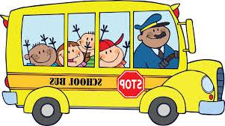
Check
homework
A C R
CAR
bread

Slide 4
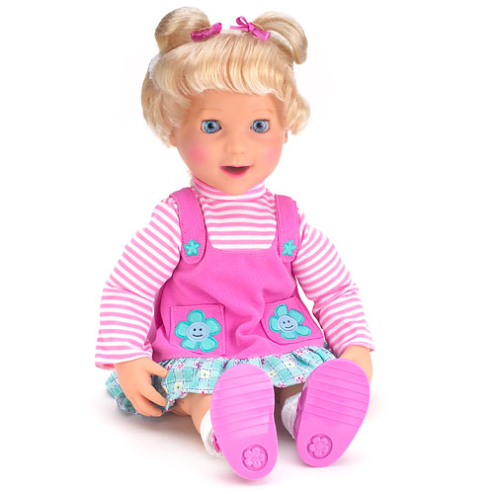
Check
homework
O L D L
DOLL
noodles

Slide 5
Check
homework
I K E T
KITE
vegetables

Slide 6
Check
homework
L B A L
BALL
biscuits

Slide 7
Check
homework
O R O T B
ROBOT
cake

Slide 8
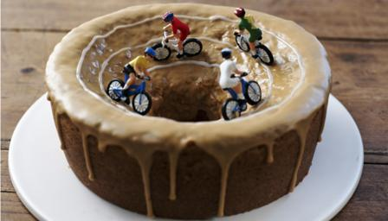
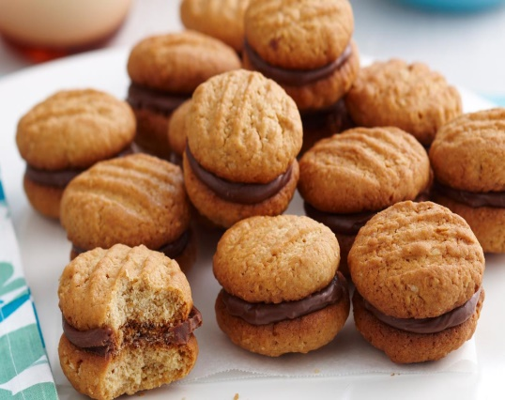
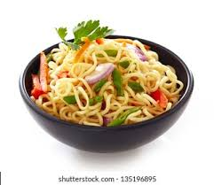
cake
bread
vegetables
biscuits
noodles

Slide 9
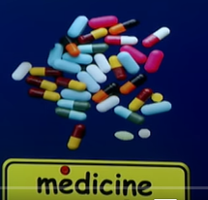

Slide 10
Vocabulary

Slide 12
1. Who are talking?
2. What do they want?
3. Where are they going?

Slide 13
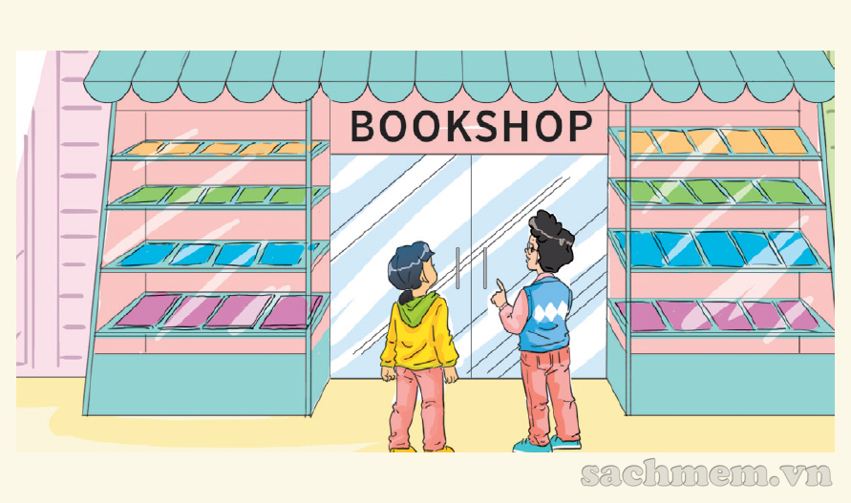

Slide 14
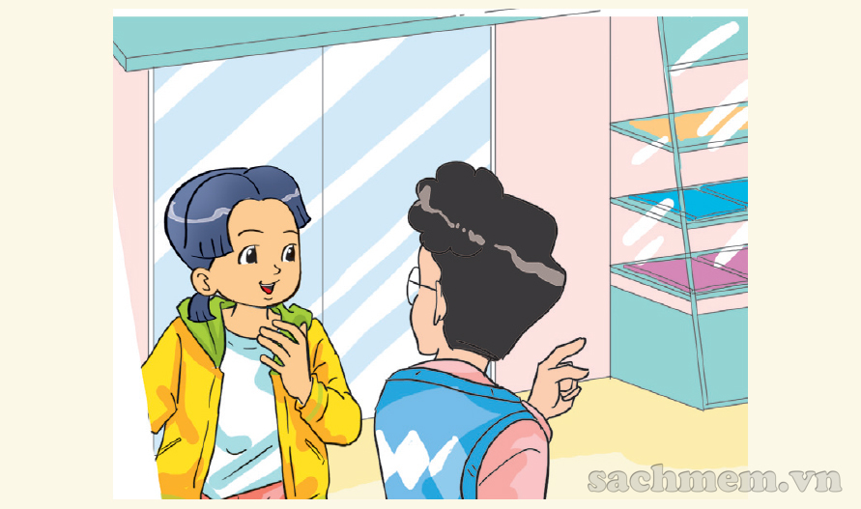
Hi, Phong. Where are you going?
Oh! I want to buy some books, too.
I’m going to the bookshop.
I want to buy some books.
OK. Let’s go to the bookshop together.
Good idea! Where’s the bookshop?
Here!

Slide 15
Guesing

Slide 16
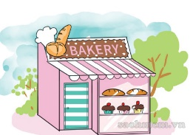
bread
cake
medicine
food
biscuits
orange juice
vegetables
notebooks
1
2
3
4
5
cake
bread
medicine
orange juice
food
vegetables
biscuits
notebooks

Slide 17
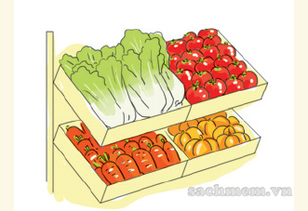
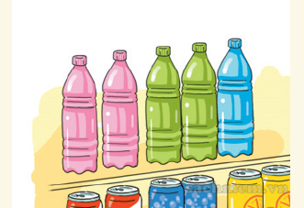
1. Where do Phong and Linda go?
a
b
2. What do they want?
a
b
3. Where do Mai and Tony go?
a
b
4. What do they want?
a
b

Slide 18
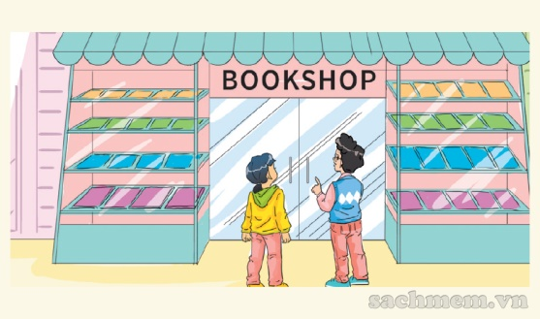
1. Vocabulary
- bookshop
- bakery
- pharmacy
- supermarket
- sweet shop
- medicine
2. Model sentence
Let’s go to the bookshop.
I want to buy some books.
Good idea!
or Sorry, I’m busy.

Slide 19
Find the Treasure
211
2
3
4
5
6
7
8

Slide 20
My mom wants some eggs. Where can she go?
The supermarket.
Notes:
Ấn nút mũi tên quay về sau khi đã hoàn thành câu hỏi và để họ sinh chon câu hỏi tiếp theo.

Slide 21
Say 1 thing you want to buy and invite one of your friend to go with you.

Slide 22
Does your mom write a shopping list before going shopping?

Slide 23
Invite your teacher to go to somewhere with you.

Slide 24
When do you go shopping with your mom?

Slide 25
Say 1 place you want to go with your friends this Sunday.

Slide 26
1. Speaking.
2. Listening.
3. Games.

Slide 27
HOMELINK
Interview your what do they want to buy to write a shopping list, where they can buy and who do they want to go with.
Make 3 sentences begin with: My mom wants to go to the ………. to buy ……….. with ………

